Slide 1
Generate 2D Normal Distribution
0852623 Andreas Rony Wijaya

Slide 2

Box-Muller Transformation
Let define
$$R=\sqrt{x^{2}+y^{2}}$$
$R^{2}=$ $x^{2}+y^{2}$
$R^{2}$ is Exp(0.5)
Let $u$ and $v$ be two independent variables uniformly distributed (0,1).
$$x=R sinΘ=\sqrt{−2\log\left(u\right)}\sin\left(2 πv\right)$$
y $=R cosΘ=\sqrt{−2\log\left(u\right)}\cos\left(2πv\right)$
$x$and $y$are two independent and normally distributed variables.

Slide 3
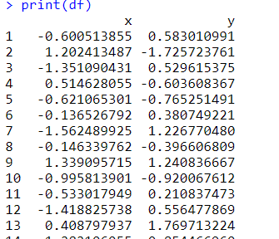
Generate 2D Normal Distribution (R Code)
#size
n = 100000
#Uniform
u = runif(n)
v = runif(n)
x=rep(0,n)
y=rep(0,n)
for (i in 1:n){
x[i] = sqrt(-2*log(u[i]))*cos(2*pi*v[i])
y[i] = sqrt(-2*log(u[i]))*sin(2*pi*v[i])
}
#Two dimensional Normal Distribution
df <- data.frame(x,y)
print(df)
twonorm <- c(x,y)

Slide 4
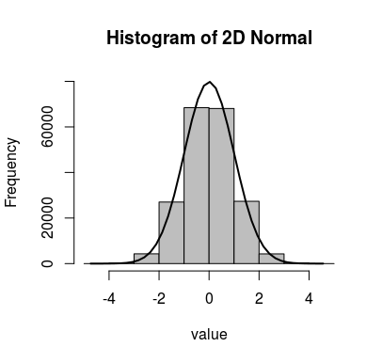
Histogram of 2D Normal Distribution
#Histogram
h <- hist(twonorm, breaks=10, col="grey", main="Histogram of 2D Normal", ylim=c(0,80000))
xfit <- seq(min(twonorm), max(twonorm), length = 40)
yfit <- dnorm(xfit, mean = mean(twonorm), sd = sd(twonorm))
yfit <- yfit * diff(h$mids[1:2]) * length(twonorm)
lines(xfit, yfit, col = "black", lwd = 2)

